Slide 1
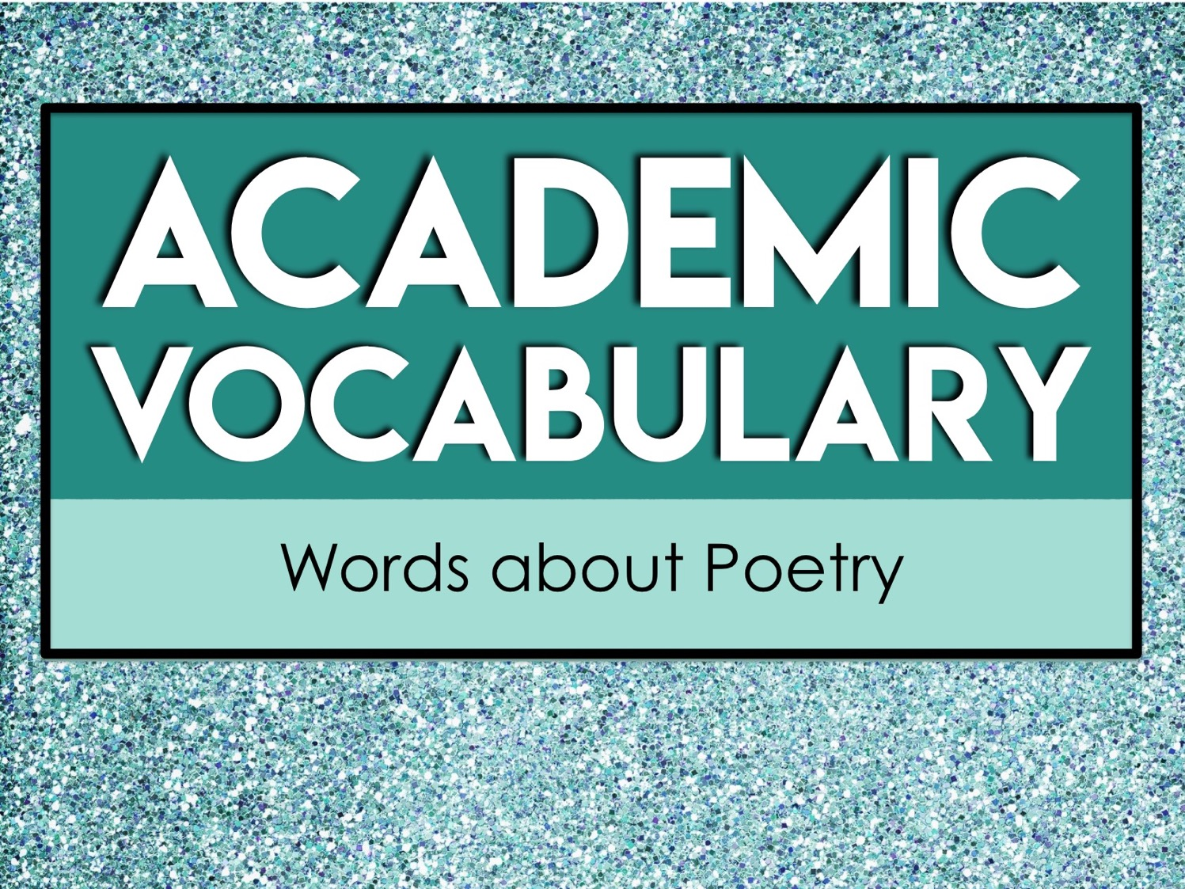
Academic
Vocabulary
Words about Poetry

Slide 2
About Academic Vocabulary
Academic vocabulary refers to words that you will likely encounter in an academic setting.
Academic vocabulary shows up in text books, standardized tests, and in instructions for school assignments.
The more academic vocabulary you know, the more likely you are to be successful in school!

Slide 3
Focus on Five at a Time
We will learn 25 new academic vocabulary terms during this unit.
However, we will only focus on five words at a time.
Each week we will have five new words to learn.

Slide 4
Our Week in Academic Vocabulary
Monday: Introduce the words.
Tuesday: Draw it out.
Wednesday: Word Web Wednesday!
Thursday: Reflect about the words.
Friday: Quiz time!
End of the unit: We will review ALL 25 of the academic words you’ve learned.

Slide 5
Monday
On Mondays, we will take a quick pretest on five new vocabulary words.
Then, we will go over each word.
You’ll write the words and their definitions on your weekly handout.

Slide 6
Tuesday
On Tuesdays, we will take a few minutes to review the words.
During this time, you’ll draw a quick visual representation for each word.
The drawings do not need to be perfect. Anything that helps you associate the word to the definition will help you!

Slide 7
Wednesday
On Wednesdays, we will take a few minutes to review the words.
During this time, you’ll create a word web for each word.
A word web is a graphic representation containing words. You’ll write words that have similar meanings and words that are associated with the vocabulary term on your paper.

Slide 8
Word Web Example
language
list
vocabulary
terms
words

Slide 9
Thursday
On Thursdays, we will take a few minutes to review the words.
During this time, you’ll look over all of the work from the week and write a brief reflection about what you learned.
Your reflection should be at least three sentences long and contain some of the vocabulary words.

Slide 10
Reflect/Journal
Your vocabulary journal/reflection should be at least three sentences long. You can use these questions to help get you started.
What did you learn about the words?
What word did you not know prior to this week?
How do these words relate to one another?
How will knowing these words help you succeed in an academic setting?

Slide 11
Friday
On Fridays, we will take a quick test on five vocabulary words from the week.
After the test, you’ll record your score and write down the words you still need to study.
As we continue with new words, make sure you go back and revisit the words you still need to learn.

Slide 12
Academic
Vocabulary
Words about Poetry

Slide 13
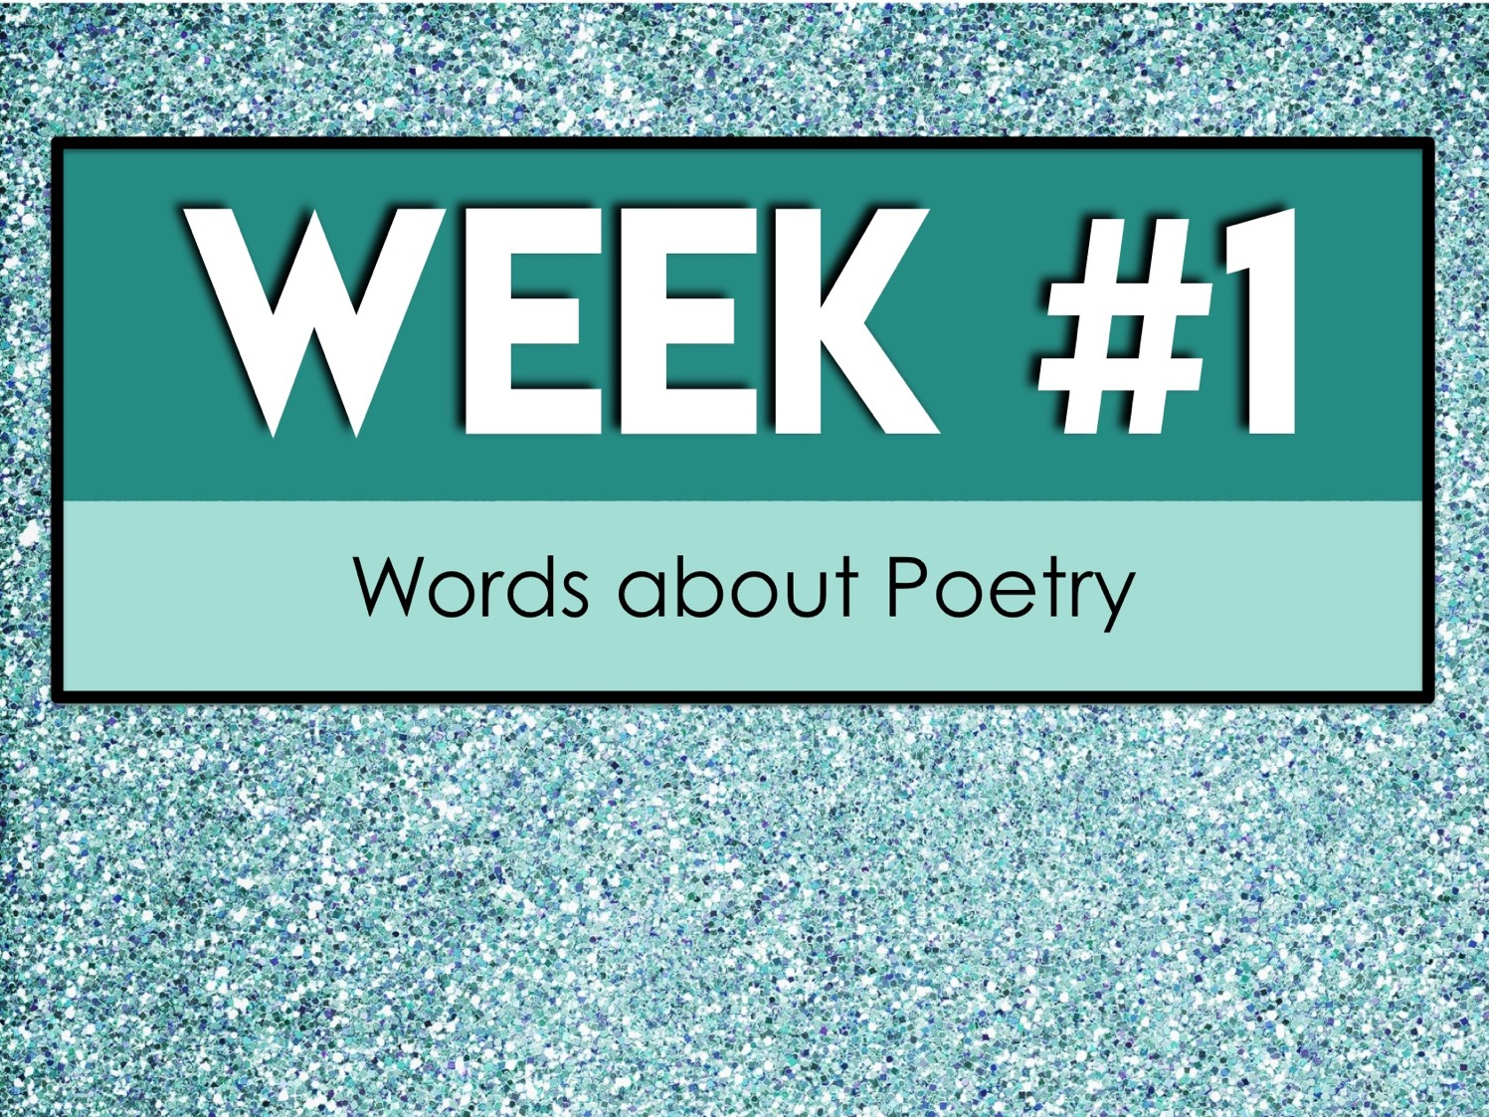
Week #1
Words about Poetry

Slide 14
Week #1 Words
Acrostic
Alliteration
Assonance
Ballad
Blank verse

Slide 15
Week #1 Pretest
DIRECTIONS: In your own words, try your best to define each term.
Acrostic
Alliteration
Assonance
Ballad
Blank verse

Slide 16
Acrostic
a poem, word puzzle, or other composition in which certain letters in each line form a word or words

Slide 17
Alliteration
the repetition of the same or similar sounds at the beginning of words

Slide 18
Assonance
in poetry, the repetition of the sound of a vowel or diphthong in nonrhyming stressed syllables near enough to each other for the echo to be discernible

Slide 19
Ballad
a poem or song narrating a story in short stanza

Slide 20
Blank verse
verse without rhyme, especially that which uses iambic pentameter

Slide 21
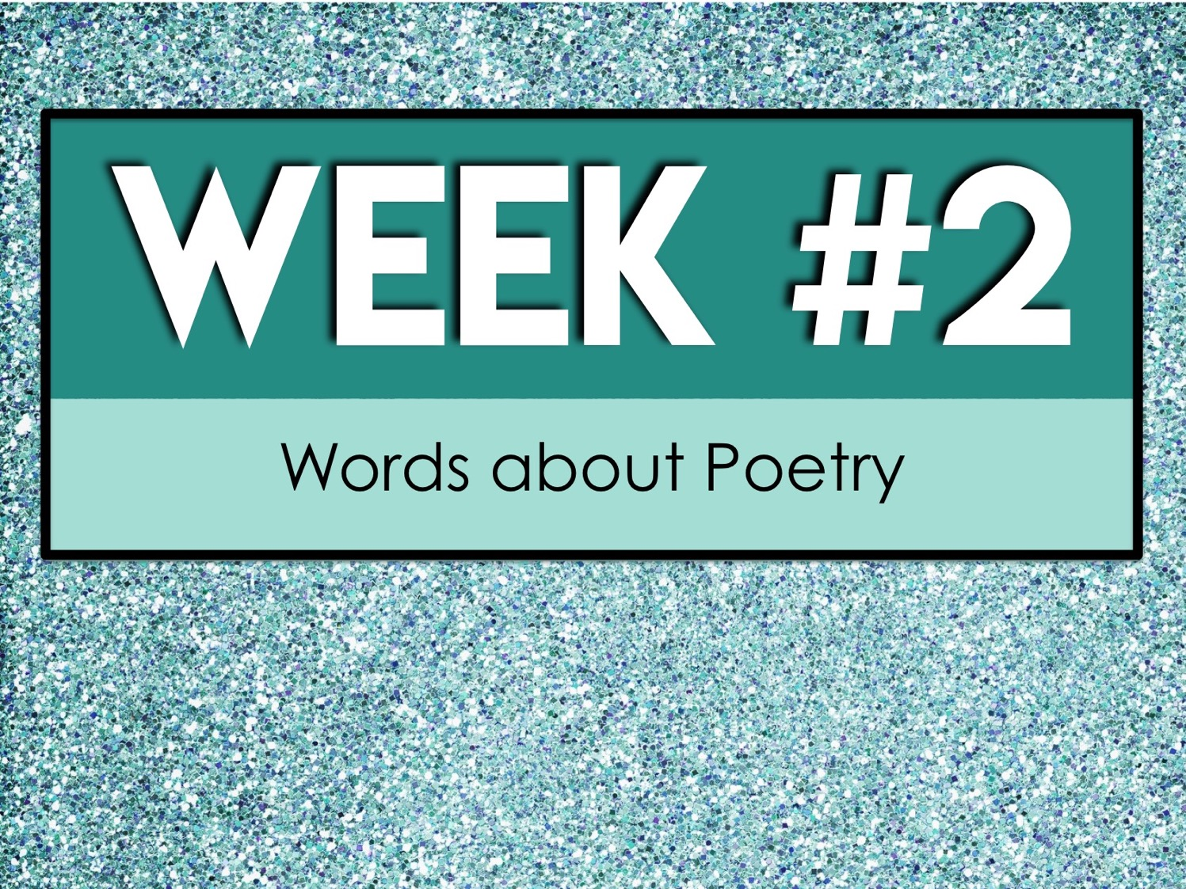
Week #2
Words about Poetry

Slide 22
Week #2 Words
Close rhyme
Couplet
Elegy
Epic
Foot

Slide 23
Week #2 Pretest
DIRECTIONS: In your own words, try your best to define each term.
Close rhyme
Couplet
Elegy
Epic
Foot

Slide 24
Close rhyme
two rhyming words that are consecutive or very close together in a phrase or line

Slide 25
Couplet
two lines of verse, usually in the same meter and joined by rhyme, that form a unit

Slide 26
Elegy
a poem of serious reflection, typically a lament for the dead

Slide 27
Epic
a long poem, typically one derived from ancient oral tradition, narrating the deeds and adventures of heroic or legendary figures or the history of a nation

Slide 28
Foot
a group of 2 or 3 syllables forming the basic unit of poetic rhythm

Slide 29
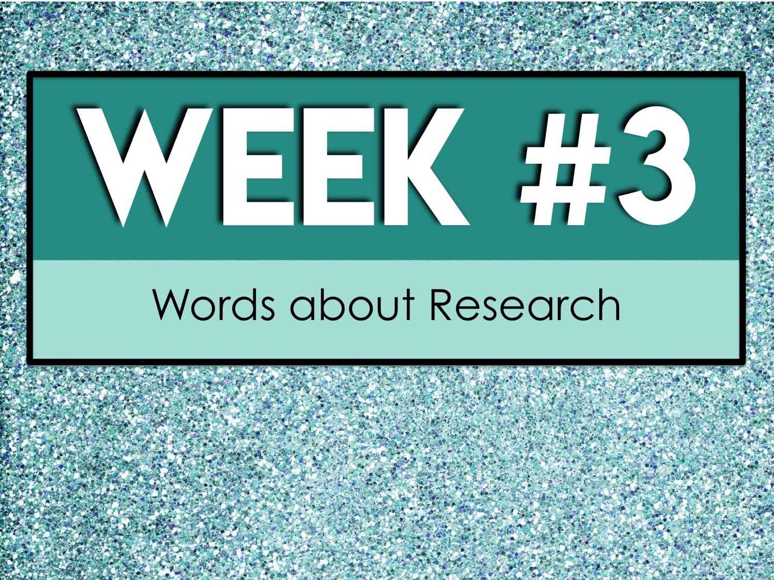
Week #3
Words about Research

Slide 30
Week #3 Words
Haiku
Iamb
Internal rhyme
Limerick
Line

Slide 31
Week #3 Pretest
DIRECTIONS: In your own words, try your best to define each term.
Haiku
Iamb
Internal rhyme
Limerick
Line

Slide 32
Haiku
a Japanese poem of seventeen syllables, in three lines of five, seven, and five, traditionally evoking images of the natural world

Slide 33
Iamb
a metrical foot consisting of one short (or unstressed) syllable followed by one long (or stressed) syllable

Slide 34
Internal rhyme
a rhyme involving a word in the middle of a line and another at the end of the line or in the middle of the next

Slide 35
Limerick
a humorous, frequently bawdy, verse of three long and two short lines rhyming aabba

Slide 36
Line
a basic structural component of a poem

Slide 37
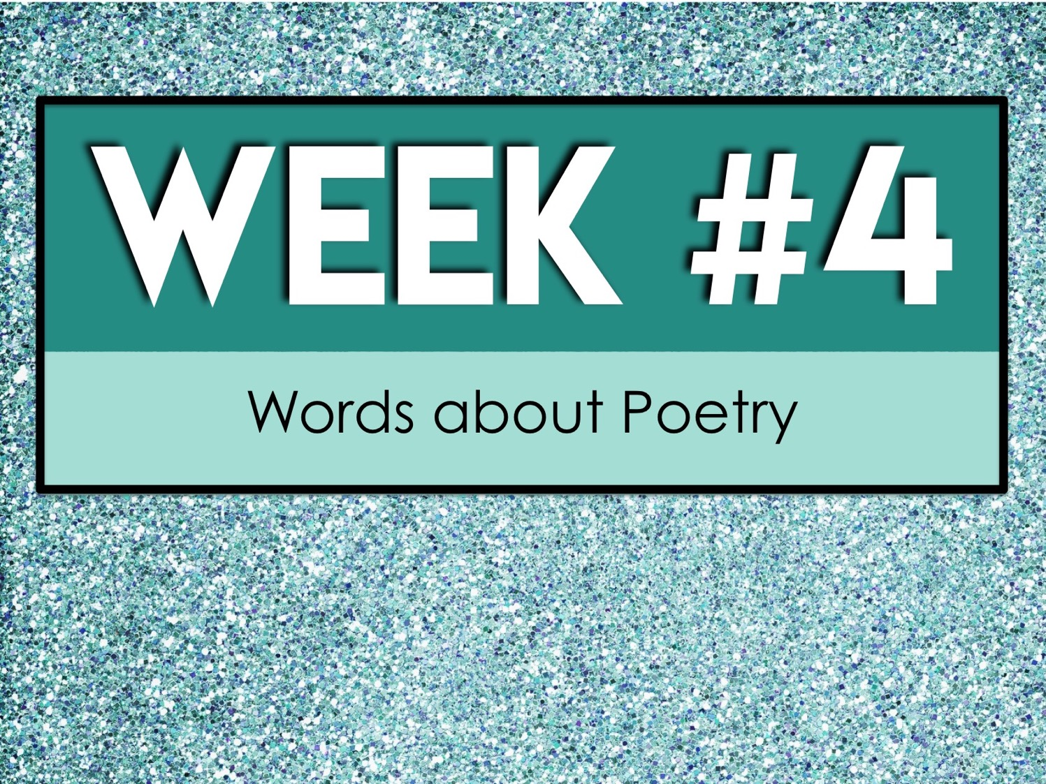

Slide 38
Week #4 Words
Lyric
Meter
Onomatopoeia
Poem
Refrain

Slide 39
Week #4 Pretest
DIRECTIONS: In your own words, try your best to define each term.
Lyric
Meter
Onomatopoeia
Poem
Poet

Slide 40
Lyric
expressing the writer's emotions, usually briefly and in stanzas or recognized forms

Slide 41
Meter
the regular pattern of stressed and unstressed syllables that make up a line of poetry and gives rhythm and regularity to poetry

Slide 42
Onomatopoeia
the formation of a word from a sound associated with what is named

Slide 43
Poem
a piece of writing that partakes in the nature of both speech and song that is nearly always rhythmical, usually metaphorical, and may contain elements as meter, rhyme, and stanzas

Slide 44
Poet
a person who writes poems

Slide 45


Slide 46
Week #5 Words
Refrain
Repetition
Rhyme
Stanza
Verse

Slide 47
Week #5 Pretest
DIRECTIONS: In your own words, try your best to define each term.
Refrain
Repetition
Rhyme
Stanza
Verse

Slide 48
Refrain
a phrase or verse recurring at intervals in a song or poem, especially at the end of each stanza; chorus

Slide 49
Repetition
a literary device that repeats the same words or phrases a few times to make an idea clearer

Slide 50
Rhyme
correspondence of sound between words or the endings of words, especially when these are used at the ends of lines of poetry

Slide 51
Stanza
a group of lines forming the basic recurring metrical unit in a poem; a verse

Slide 52
Verse
writing arranged with a metrical rhythm, typically having a rhyme

